Slide 1
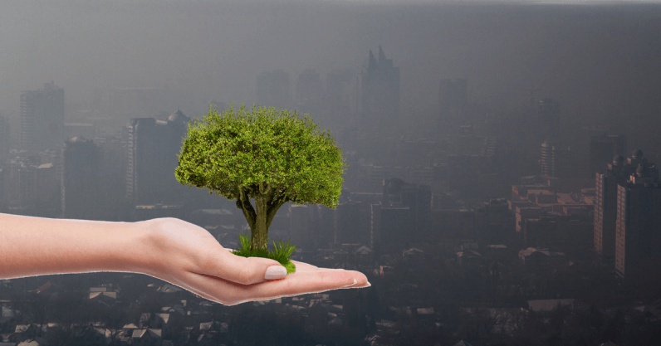
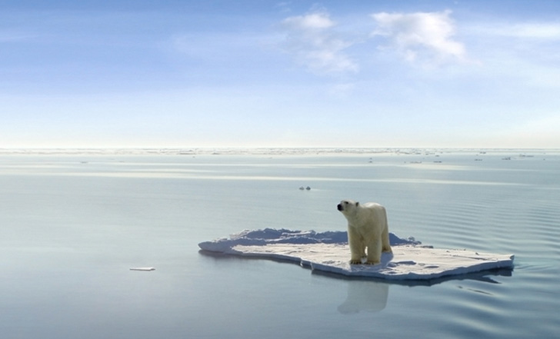
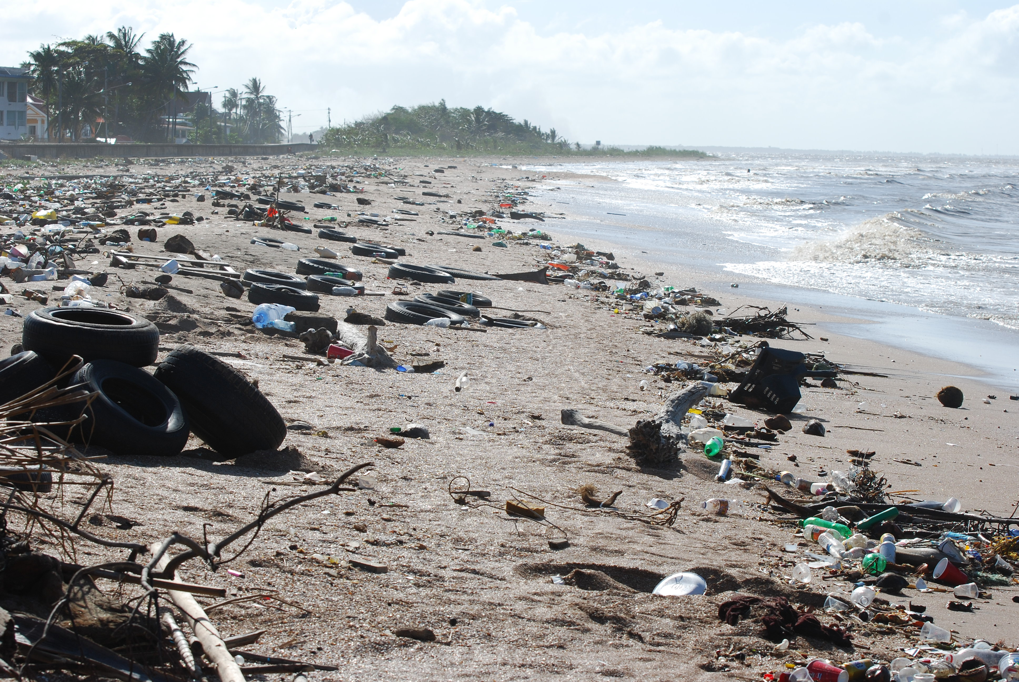

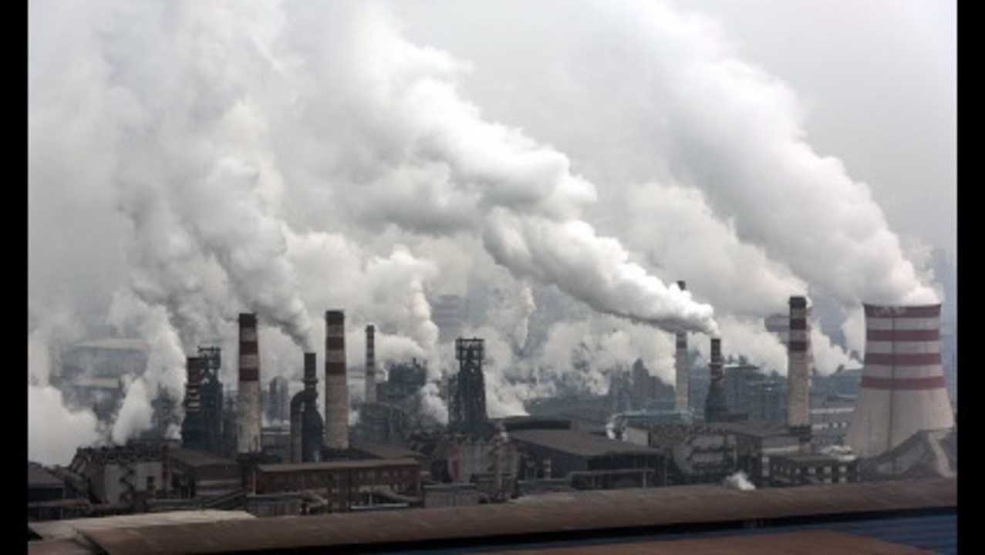
POLLUTION

Slide 2
GO GREEN
Make sustainability fun!
By Alec, Dragos, Ivaylo, Wouter, Jeroen, Sinan, Jochem

Slide 3
Content
Design
Back-end
Process
Demo

Slide 4
Design
Simple
Contrast
Sustainability

Slide 5
Back-end
Spring
Server structure
Independent data
GUI
Controller
Service
DAO
SERVER
DATABASE

Slide 6
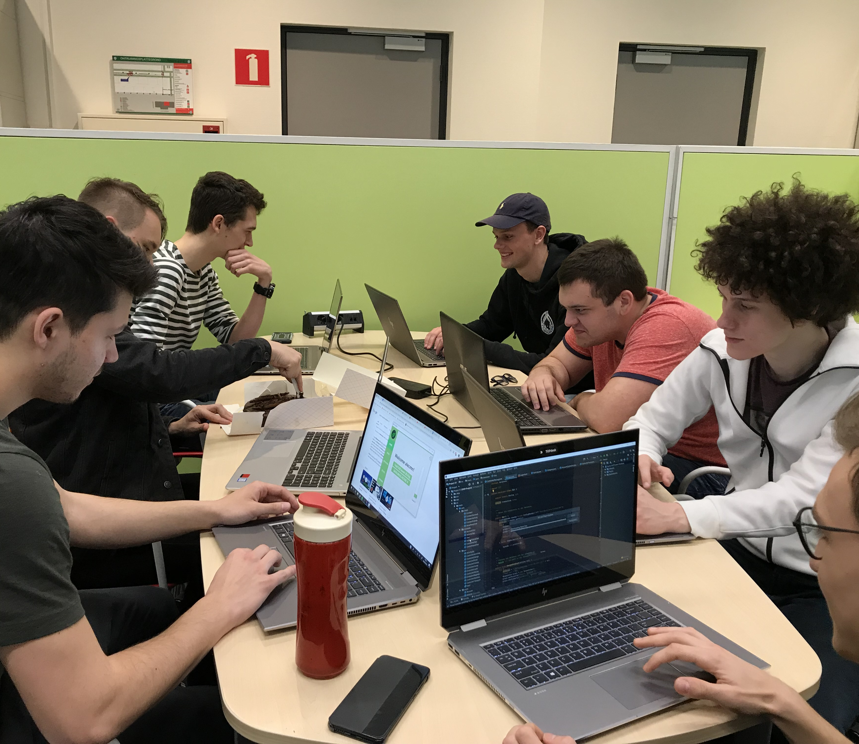
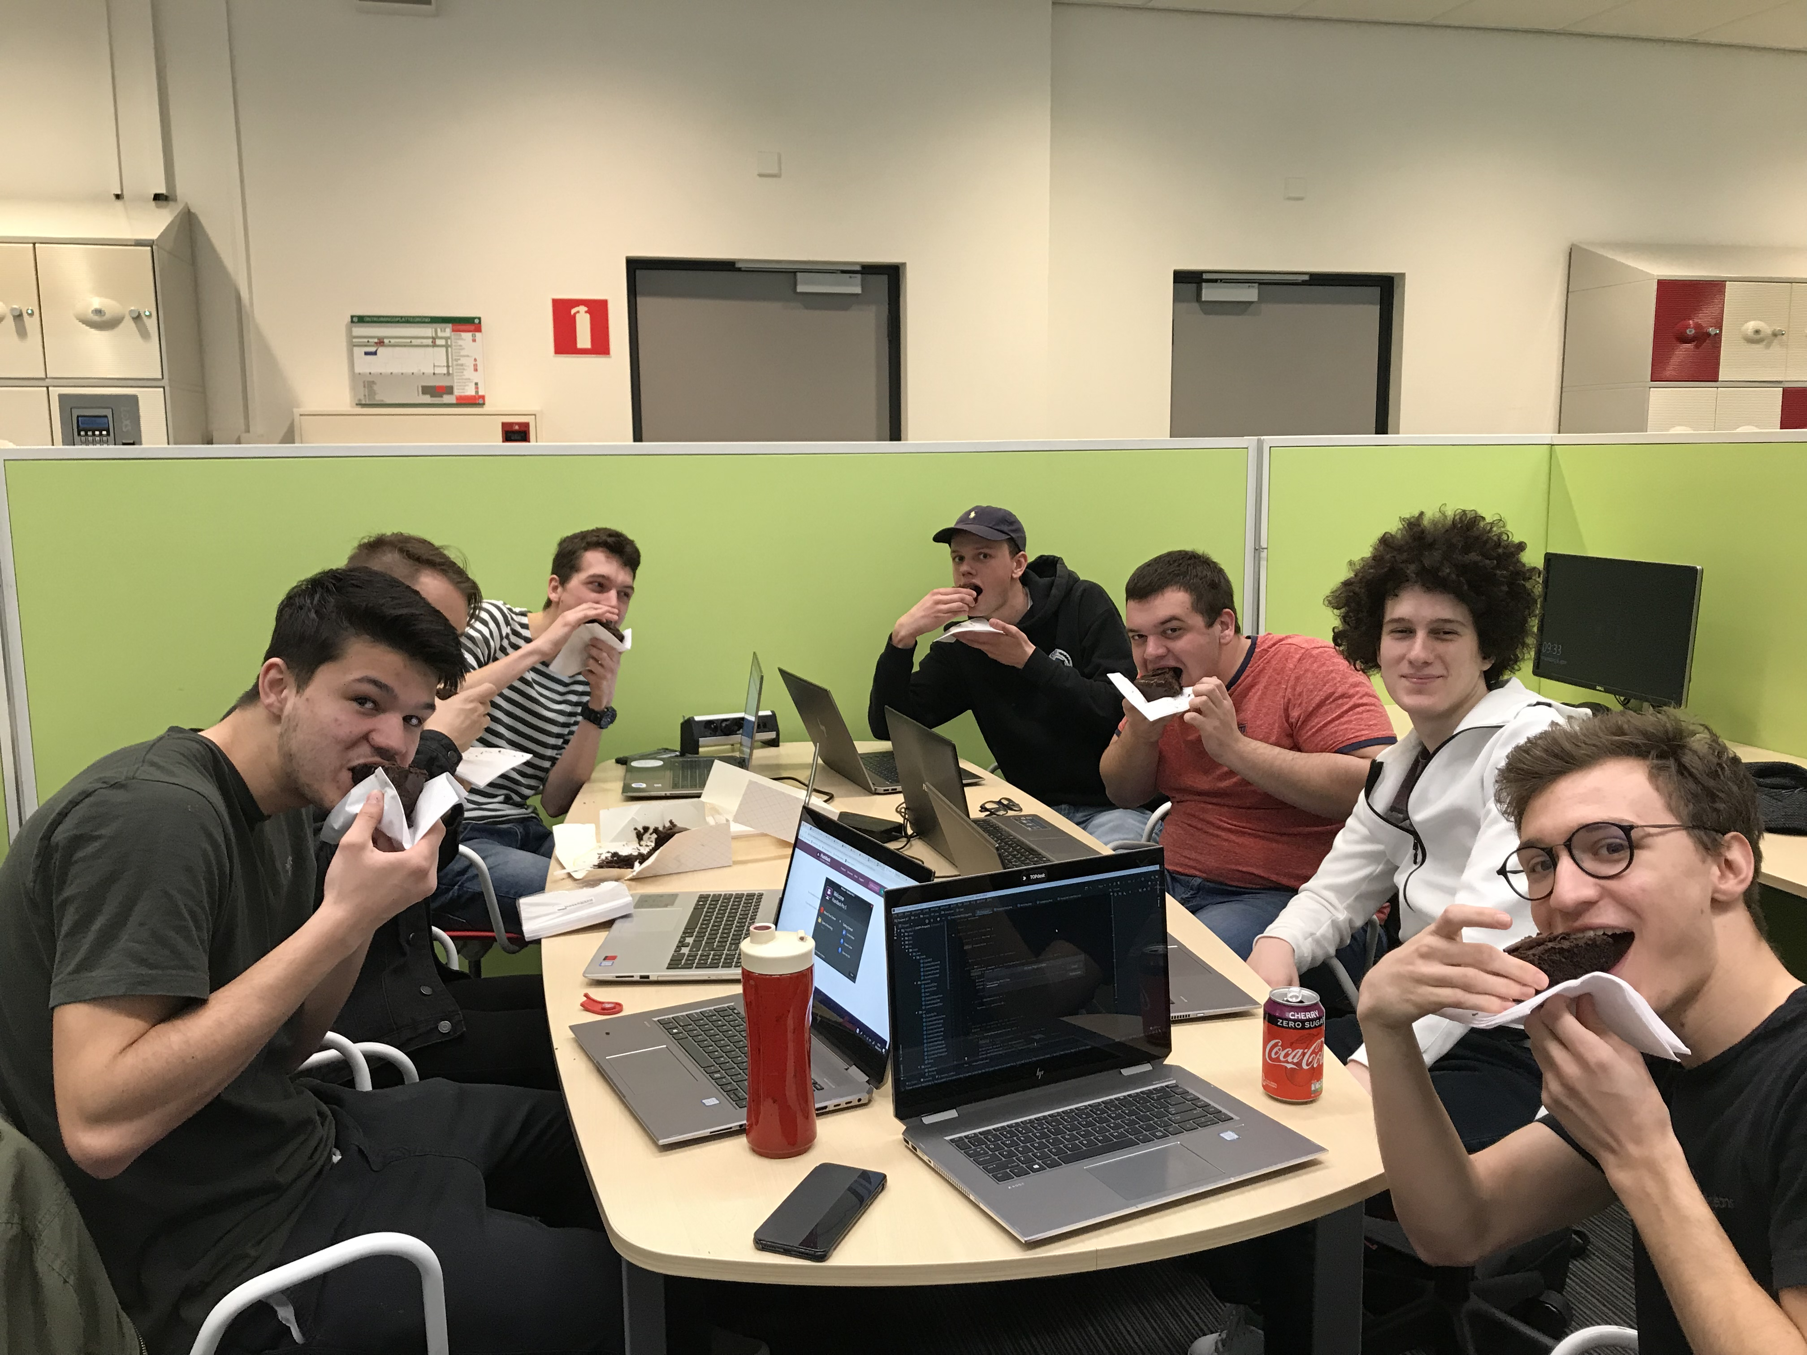
Process
SCRUM, GitLab
Divide disciplines
Meetings

Slide 7
Demo time!

